Slide 1
Objective of the Project Trying to SOLVE TWO problems 1) Primary: dine out options are limited due to friends and family’s dietary restrictions 2) Secondary: overwhelmed by Too much information on the internet

Slide 2
Technical Summary Data gathering: web scraping Data Cleaning: Panda Dataframe Database: mySQL Big data: NLTK Sentiment Analysis Others: Flask powered web application with D3, MAPboX

Slide 3
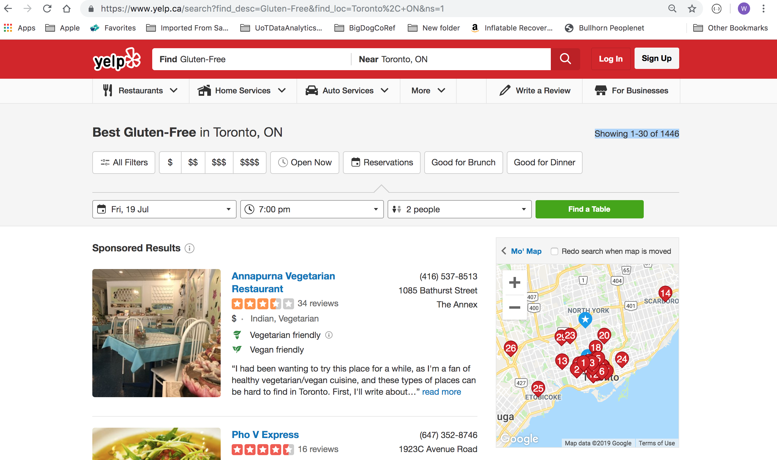

Webscrap over 1,000 restaurants

Slide 4
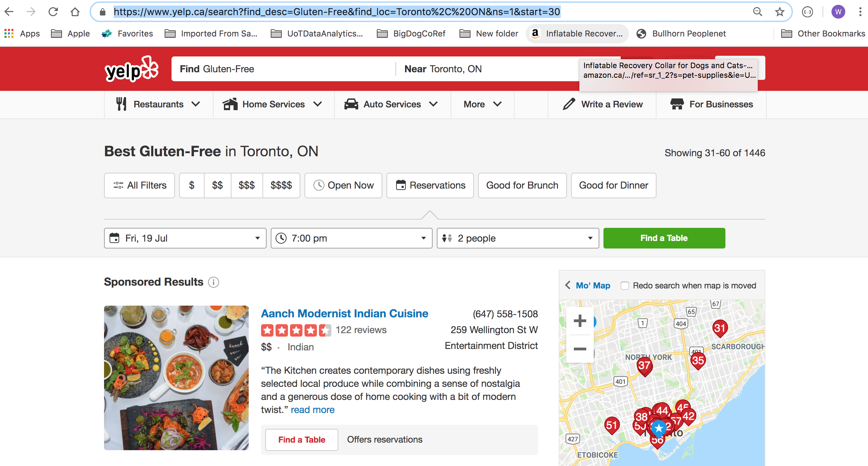

Use url to loop through restaurants and comments

Slide 5
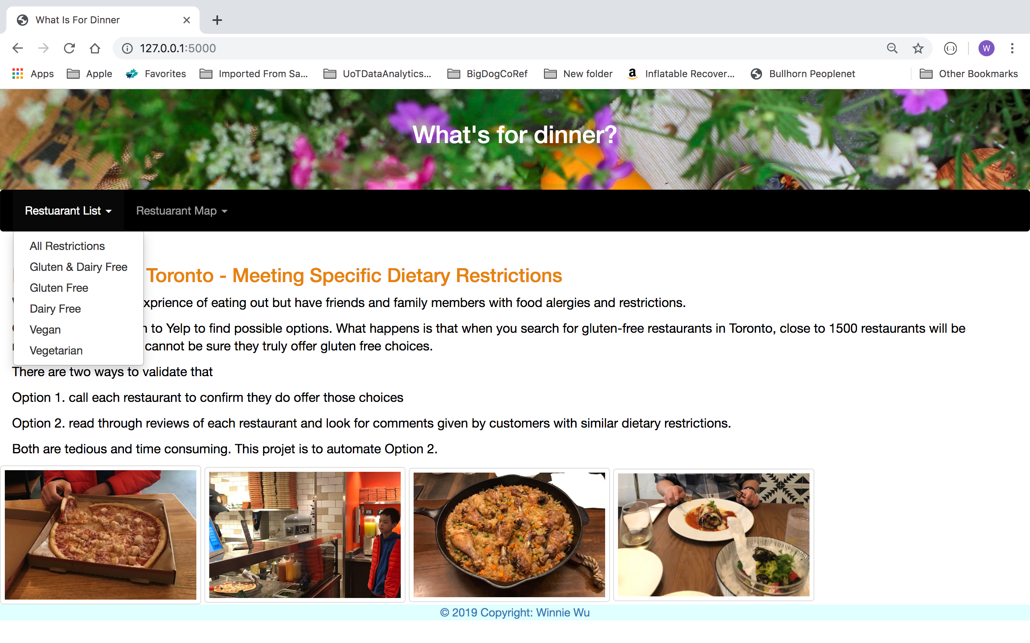
Use flask to
- Render 5 different html (Index, List, Details, Map, UpdateSuccessful)
- Retrieve dataset dynamically depending on restriction selected

Slide 6
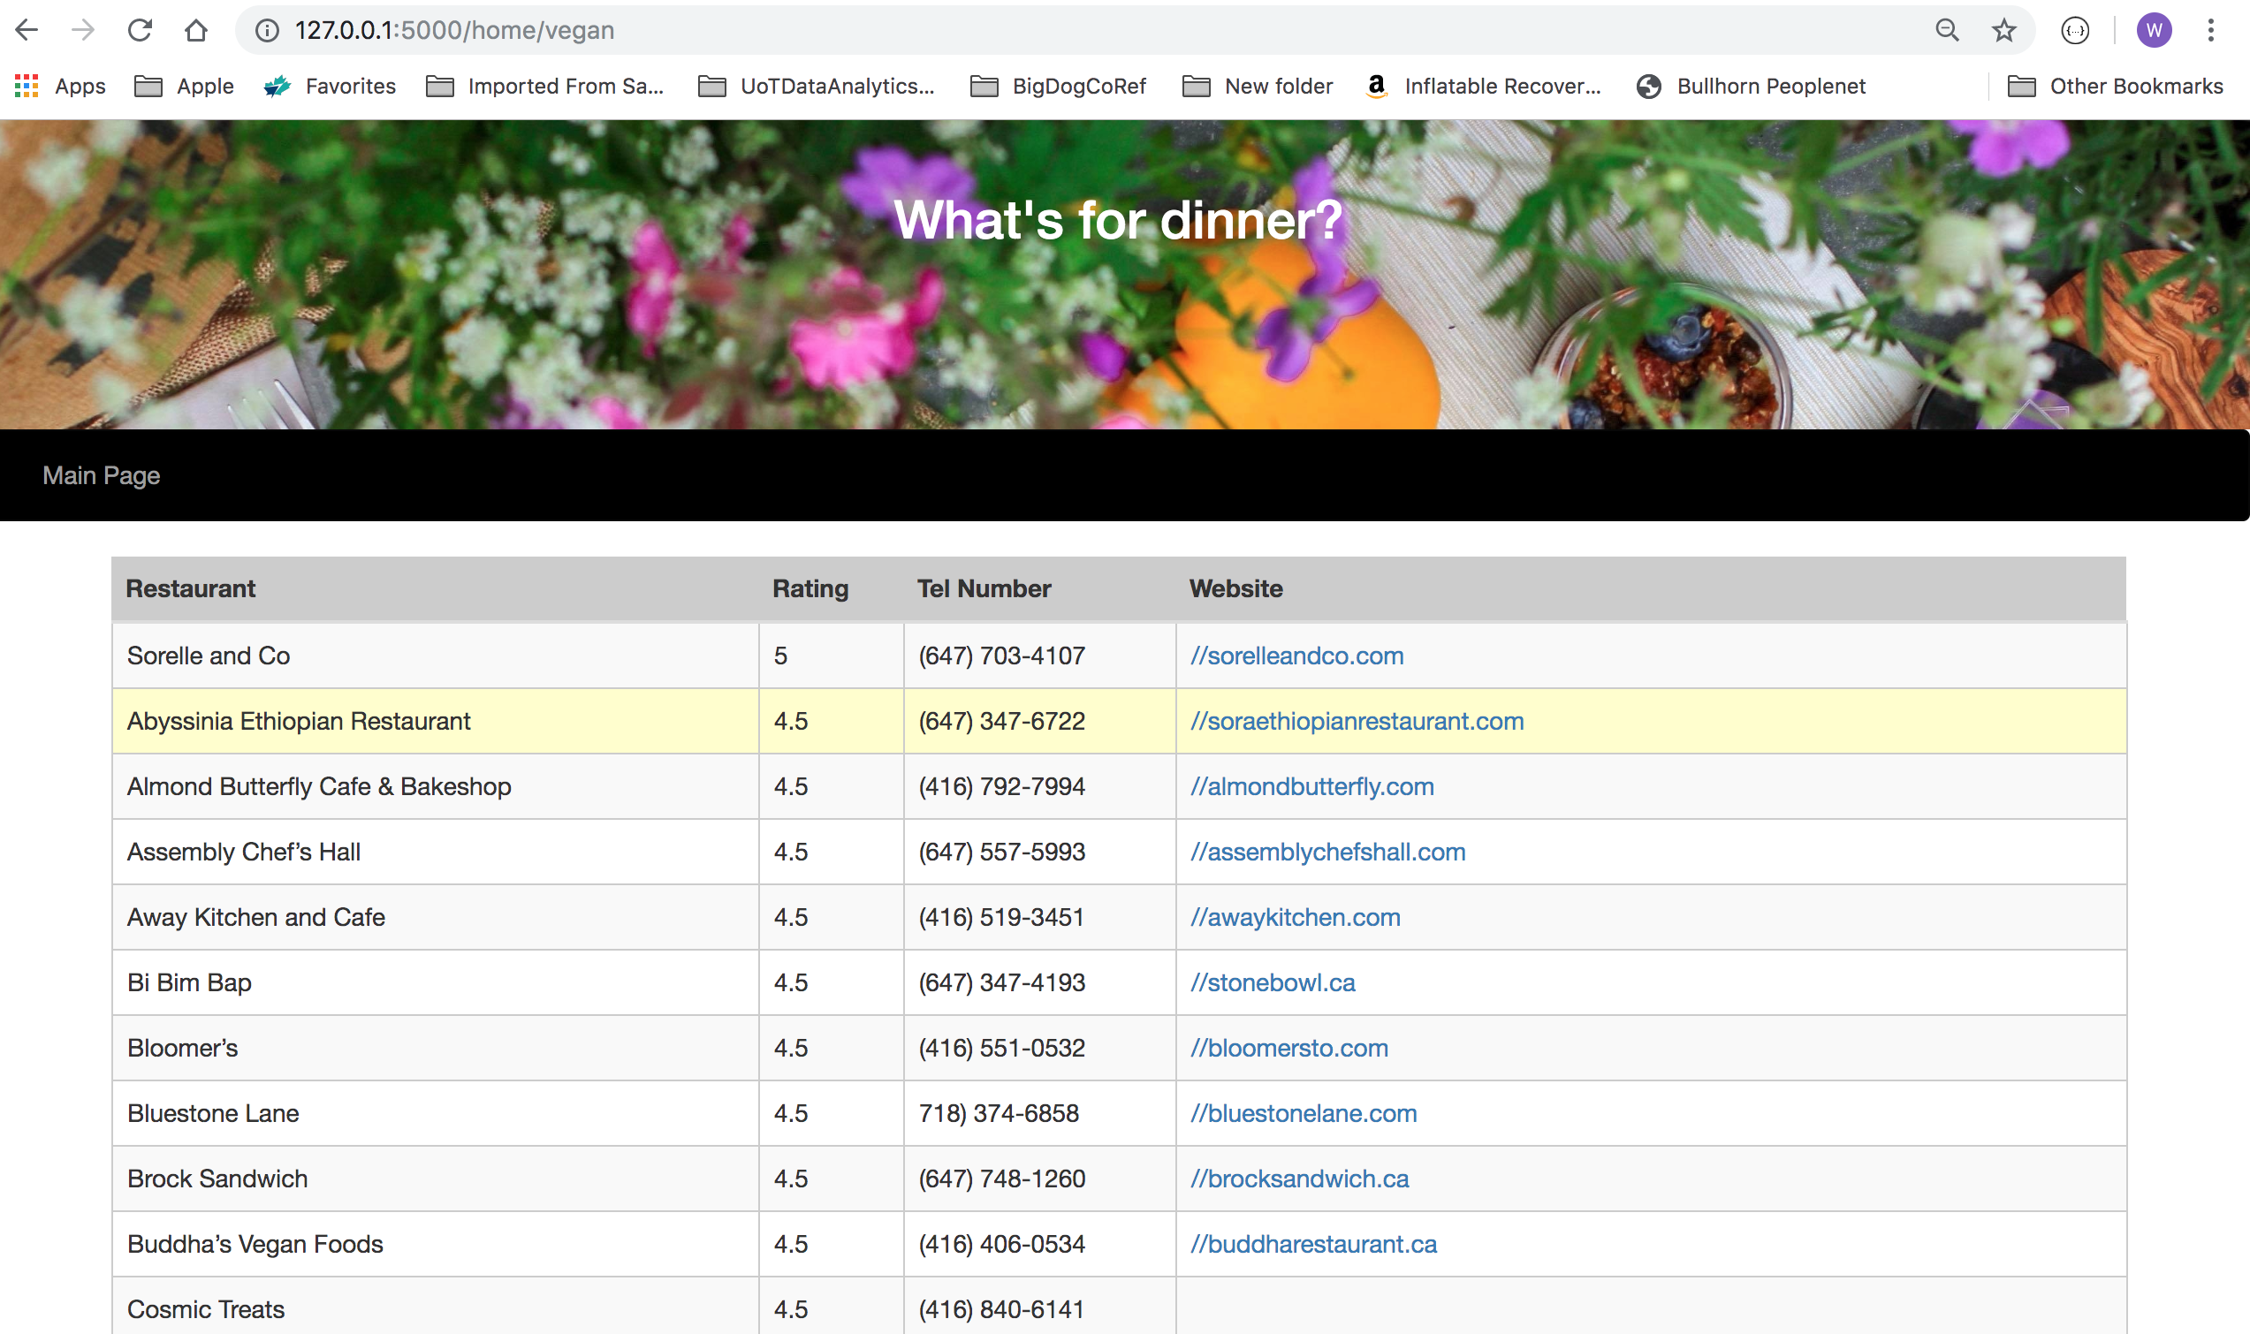
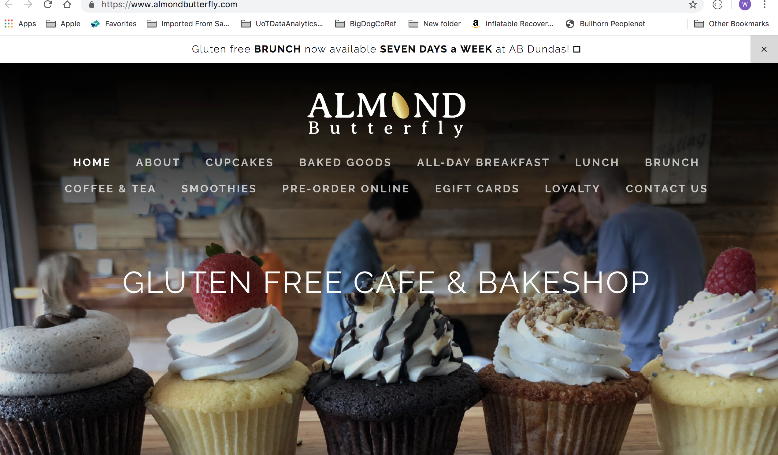
Click on website link will go to restaurant web site

Slide 7
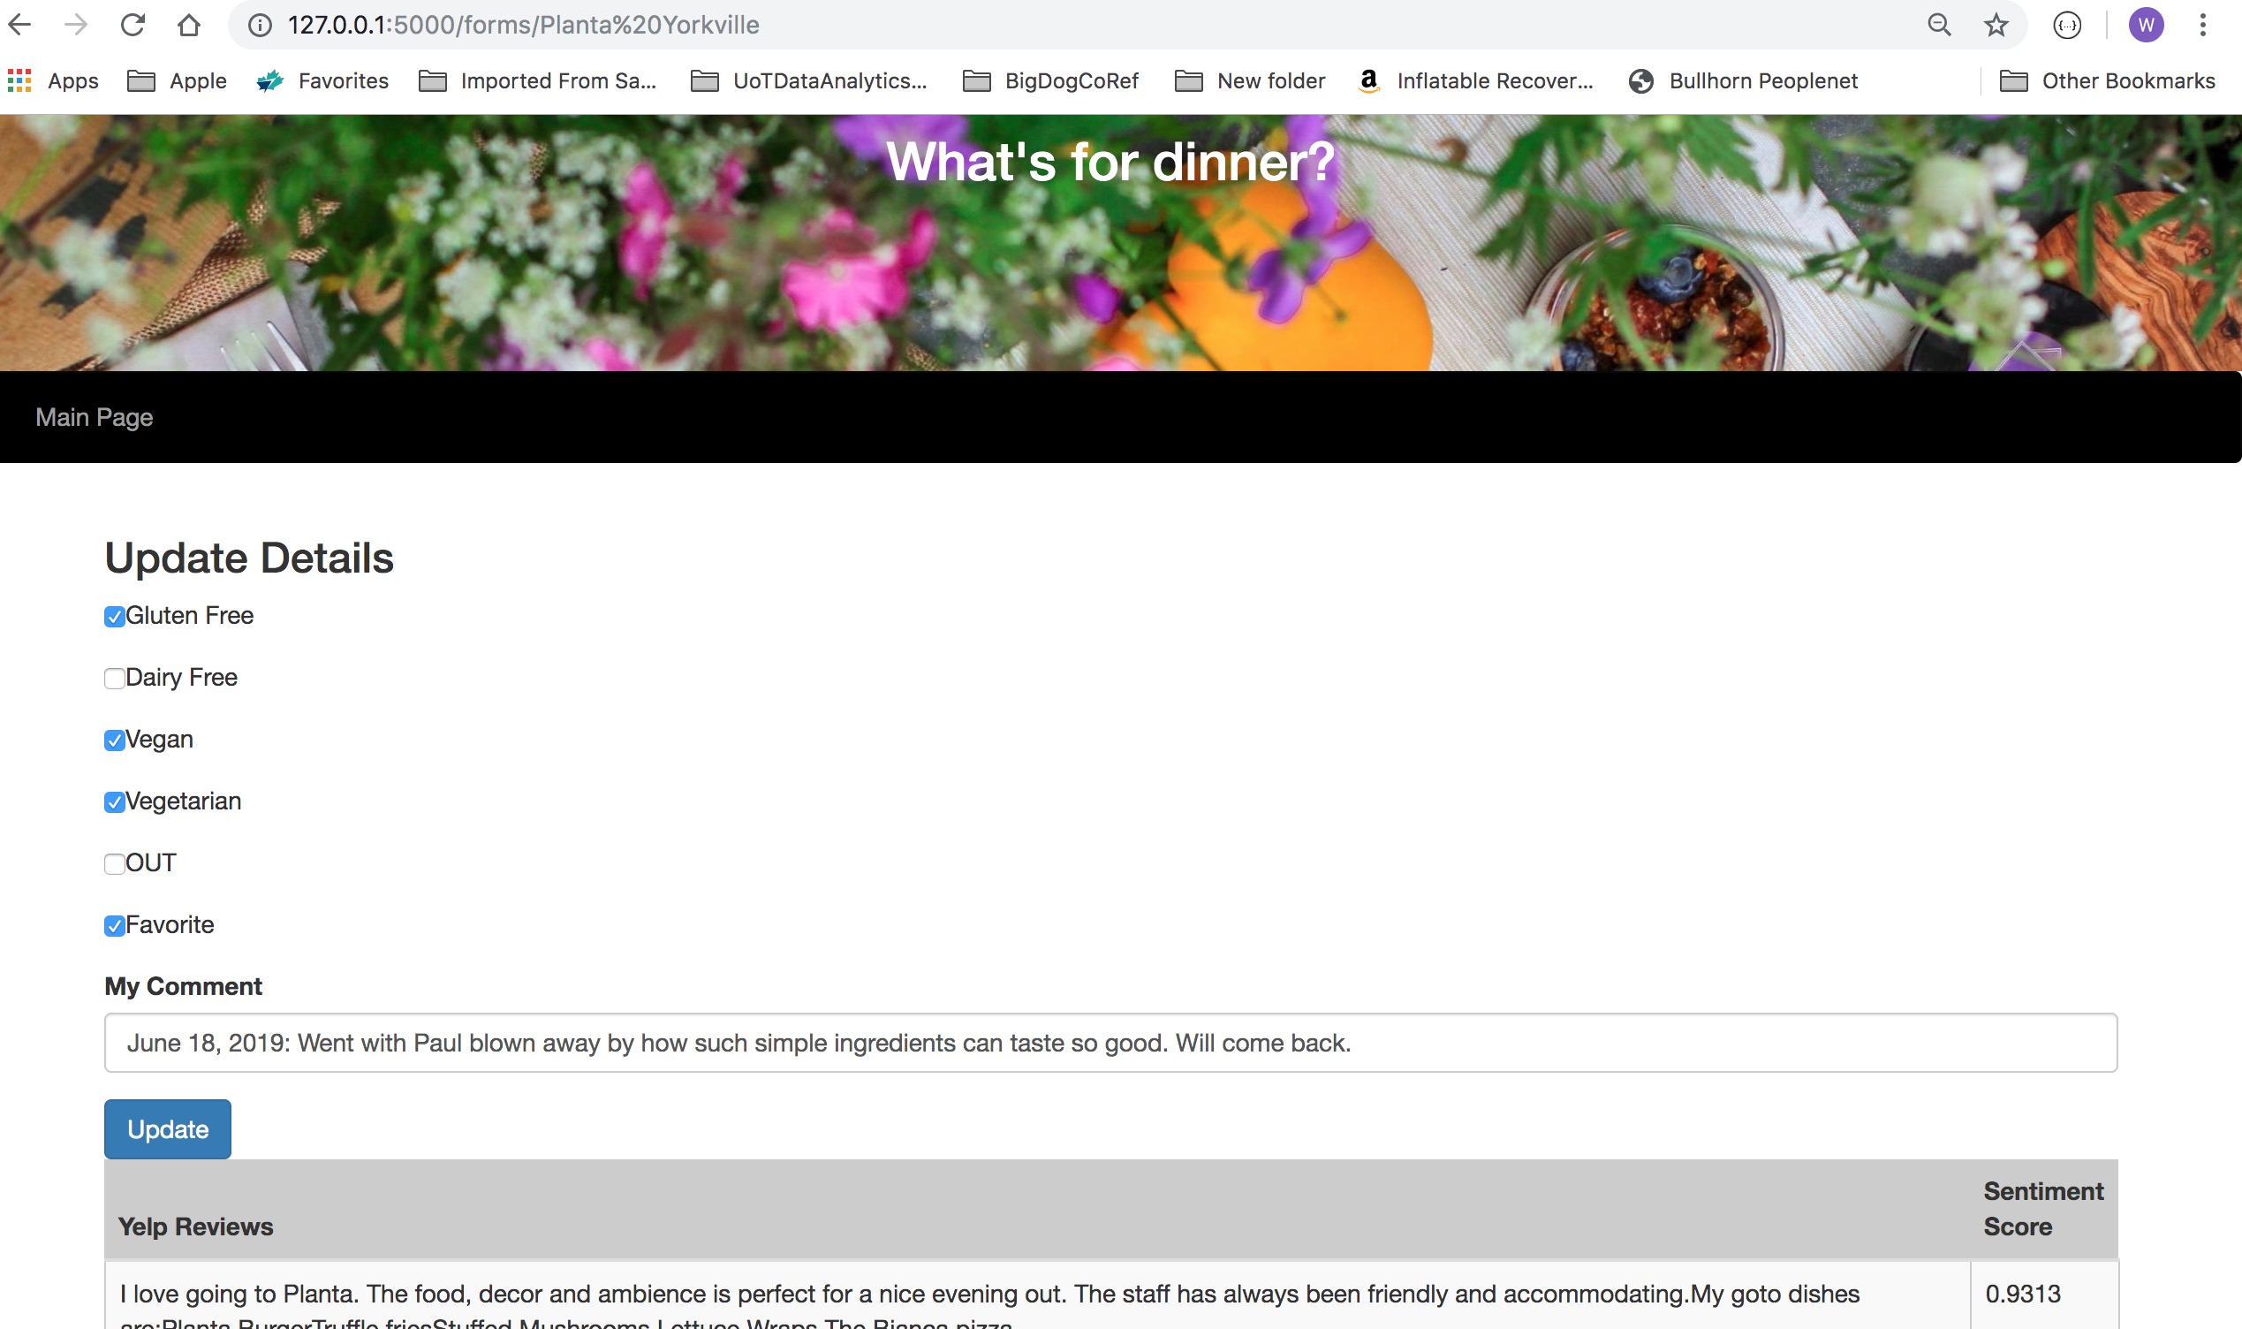
Can update based on my own experience with the restaurant
If updated as OUT will not be retrieved in the future

Slide 8
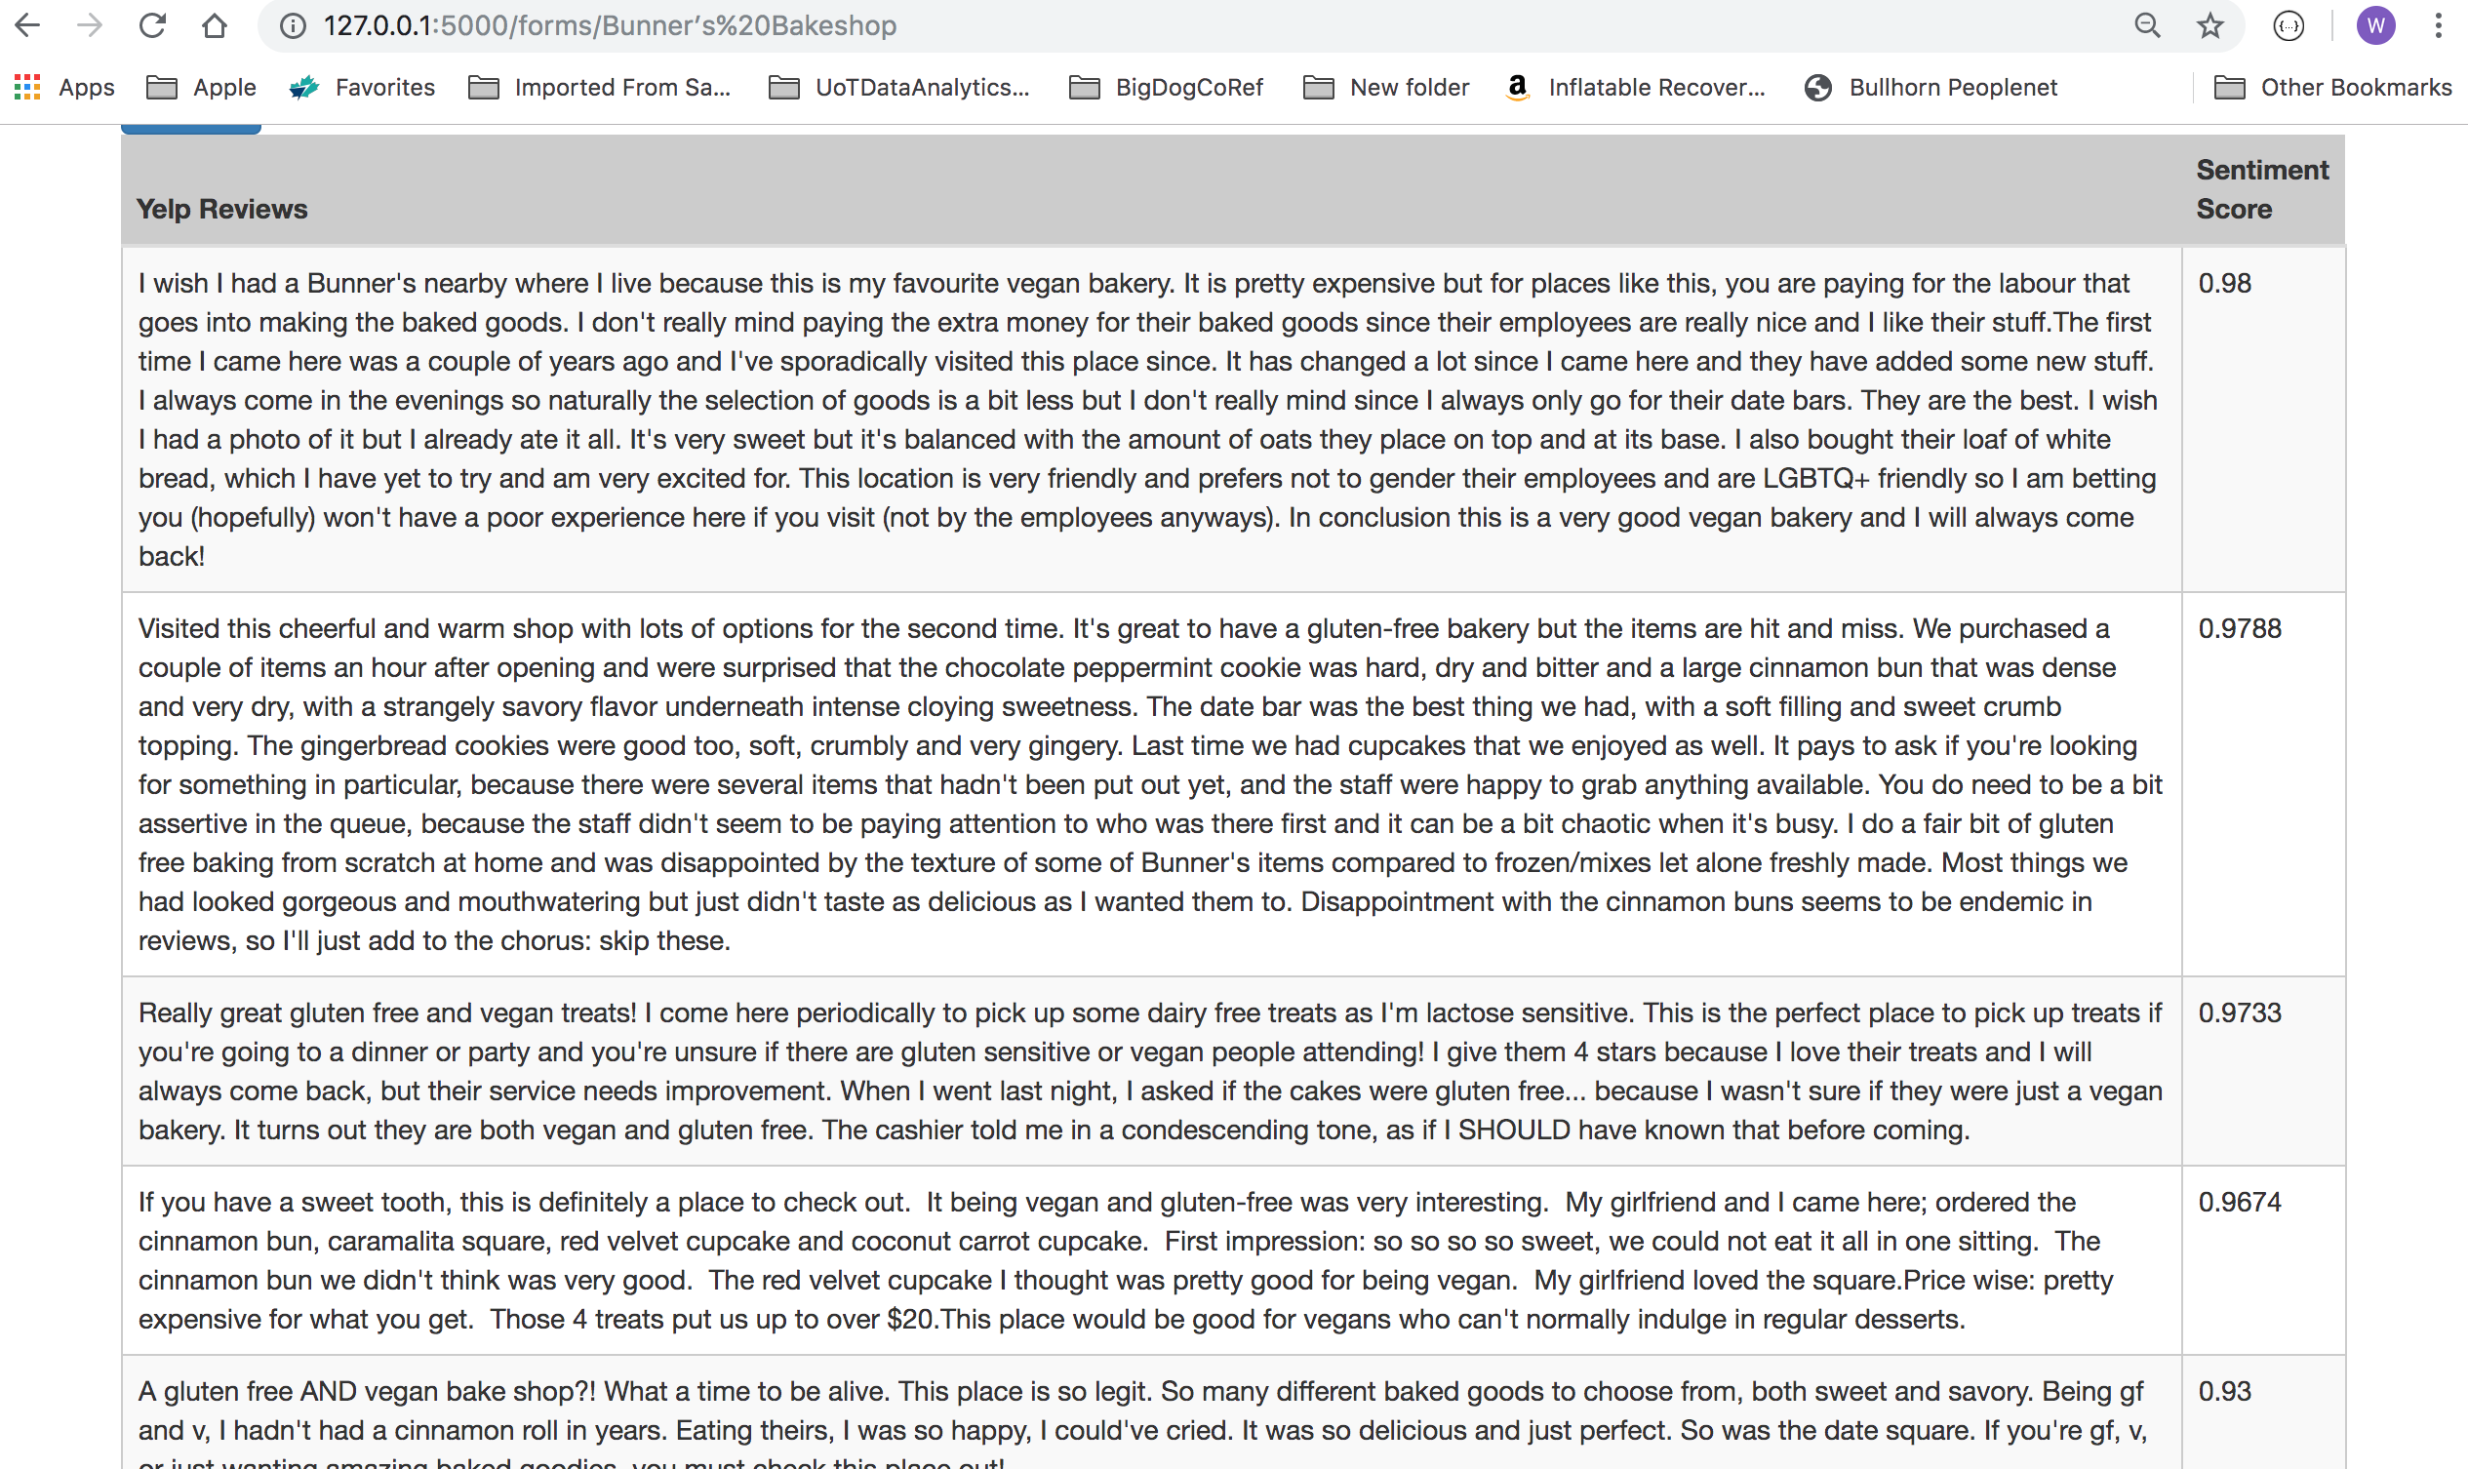

Yelp reviews are show in order of Sentiment Score (high to low)

Slide 9
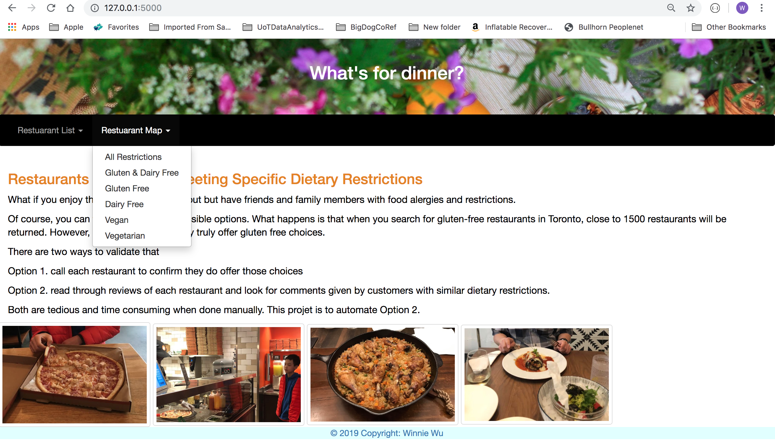

Slide 10
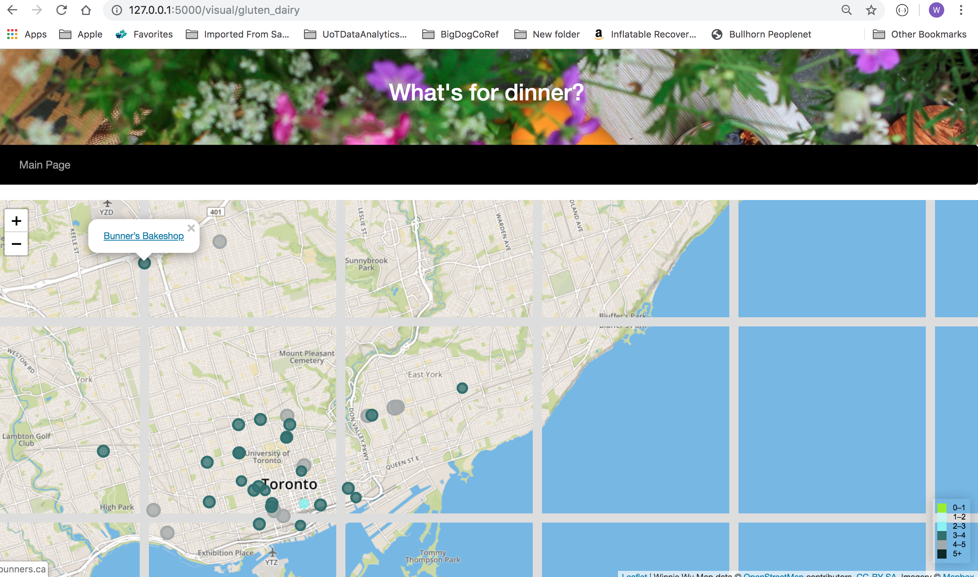

Slide 11
